Slide 1

AIRPLANE CRASH ANALYSIS with Power BI
Project By:
Divyank Yadav

Slide 2
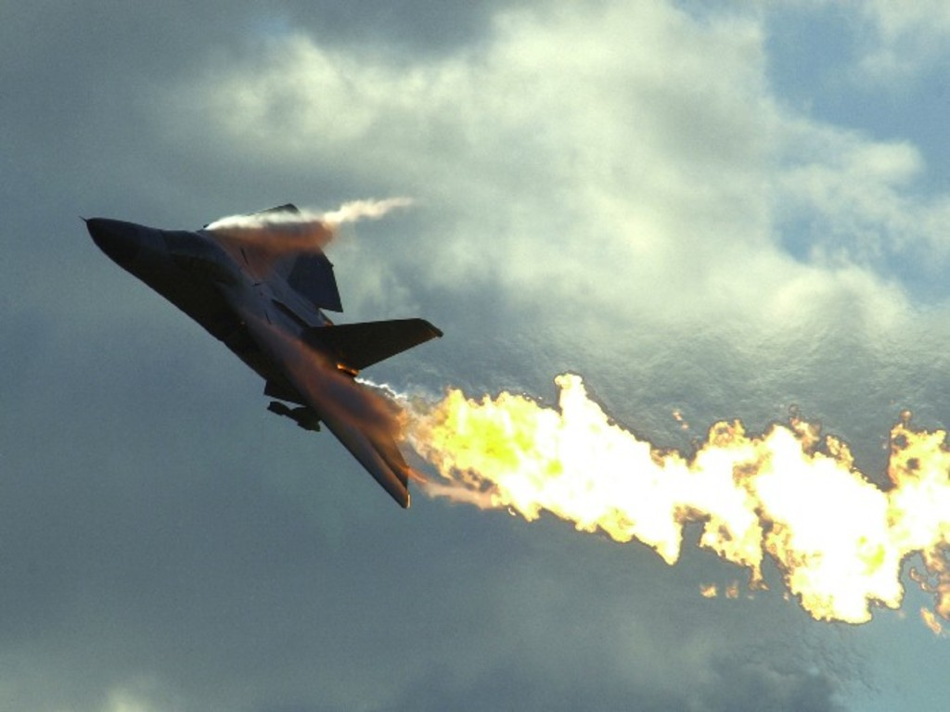
Content
Problem Statement
Objective
Dashboards
Temporal Analysis
Geospatial Analysis
Fatality Trends
Analysis
Summary

Slide 3

Problem Statement
This project's primary goal is to thoroughly analyze aviation fatalities and crashes from 1980 to 2023. The dataset contains crucial information such as crash dates, locations, operators, flight details, aircraft types, and fatality statistics. This analysis aims to understand patterns, contributing factors, and trends in aviation incidents. Analysis helps in increasing aviation safety.

Slide 4
Objective
Aircraft Analysis:
Analyze the involvement of specific aircraft types in incidents.
Examine the relationship between aircraft registration and crash occurrences.
Fatality Trends:
Explore trends in passenger and crew fatalities. Investigate factors contributing to fatalities.
Route Analysis:
Analyze incident patterns on specific flight routes.
Identify routes with a higher likelihood of incidents
Temporal Analysis:
Explore temporal trends in airplane crashes over the years.
Identify patterns in the frequency and severity of incidents.
Geospatial Analysis:
Visualize crash locations on a map to identify hotspots.
Analyze the distribution of incidents across different regions.
Operator Performance:
Evaluate the safety records of different operators and airlines.
Identify operators with higher incident rates.

Slide 5
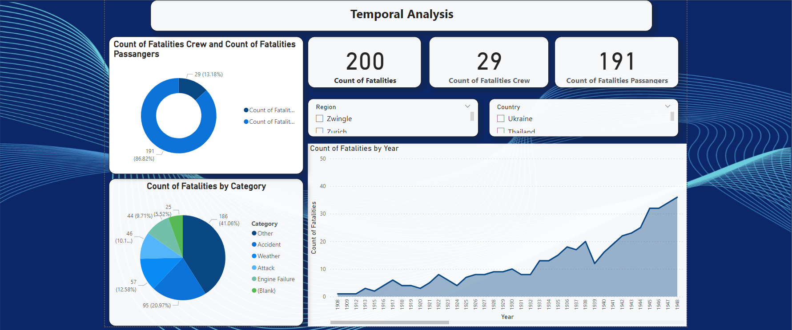

Slide 6
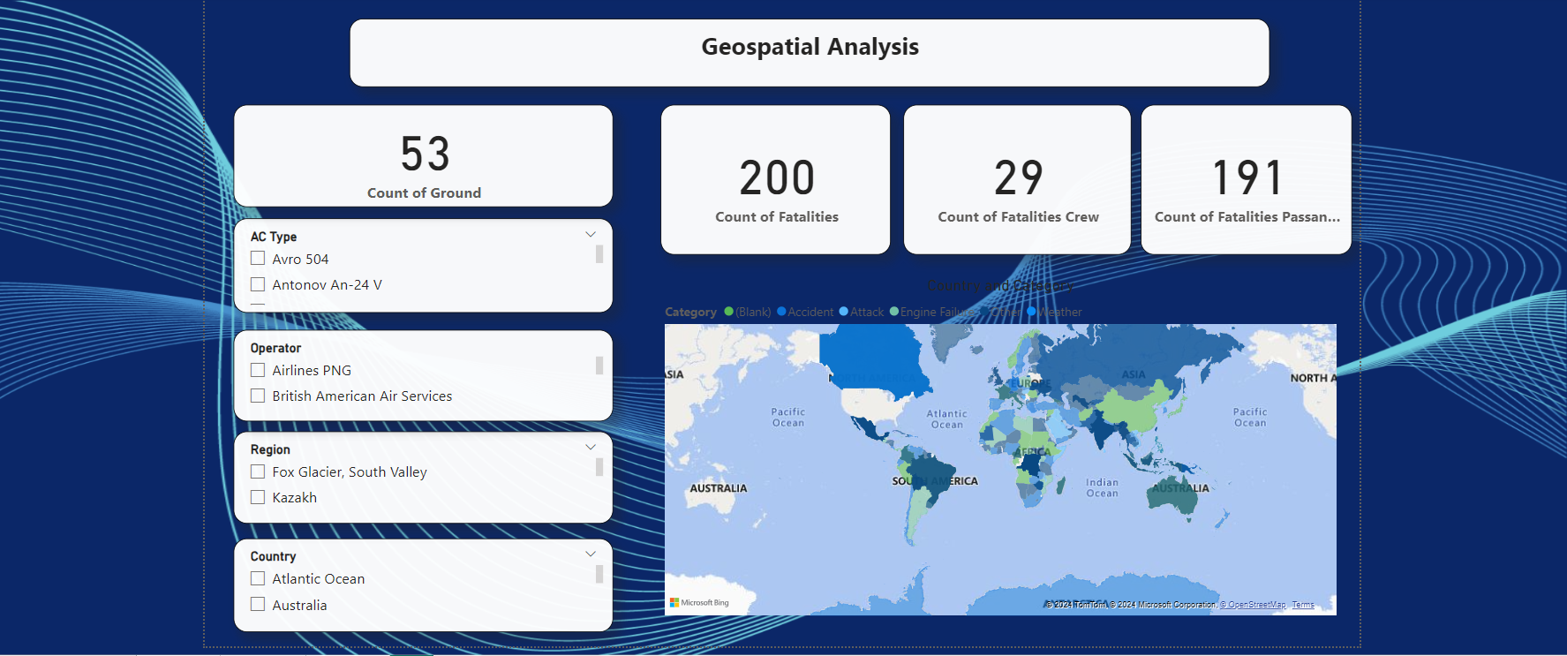

Slide 7
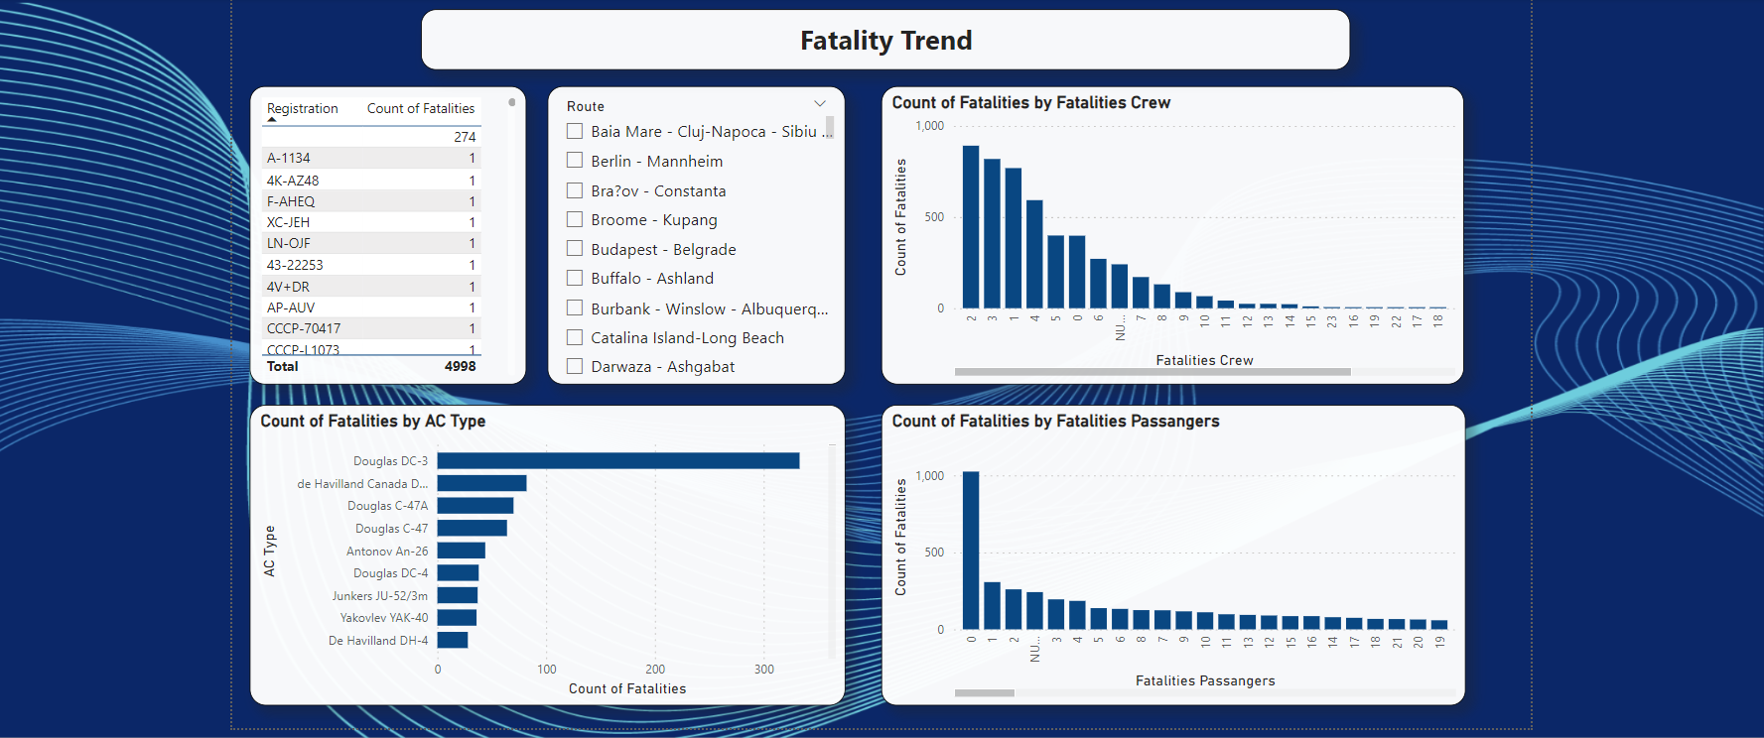

Slide 8
Analysis
The sum of fatalities value fluctuates over the years as it increases from 1908 and in 1972 the count of fatalities is maximum then it starts decreasing up to 2023.
Got the percentage distribution between fatalities crew(13%) and fatalities passengers(87%) according to different scenarios.
Count of fatalities, fatalities crew, and fatalities passengers according to different regions, countries, Aircraft Types, and Operators.
By visualizing crash locations on a world map, hotspots of incidents were identified, to focus attention on regions with higher incident rates.
The count of fatalities is decreased as the no of fatalities of crew increases.
The count of fatalities is decreased as the no of fatalities of passengers increases.
Douglas DC-3 has the maximum count of fatalities.
Analyse variation in the count of fatalities according to different Routs and Registration of Aircraft.

Slide 9
Summary
The project is centered on conducting a thorough analysis of airplane crashes and fatalities spanning from 1980 to 2023, with the overarching goal of improving aviation safety and reducing risks. Employing robust data analytics tools like Power BI, we delve into temporal trends, incident severity, and factors contributing to fatalities. By properly analyzing the geospatial pattern, fatalities trends according to various factors help to get actionable information for proactively enhancing aviation safety standards, ultimately contributing to a safer air travel environment.

